Slide 1

Receipt & Invoice Digitiser
A comprehensive solution for converting physical receipts into structured digital data through advanced optical character recognition and intelligent processing.
KAVETI HARINI
harinikaveti2003@gmail.com

Slide 2





Milestone 1 Objective
Upload Receipt Files
Enable users to seamlessly upload receipt images in multiple formats for processing.
Clean Images for OCR
Apply advanced preprocessing techniques to enhance image quality and readability.
Extract Raw Text
Convert visual receipt data into machine-readable text format using OCR technology.
Core Focus: This milestone concentrates on transforming physical receipts into readable, structured text data that can be further processed and analysed.

Slide 3
Technologies Used
Our solution leverages a carefully selected technology stack that combines powerful libraries and frameworks to deliver robust document processing capabilities.
Streamlit
OpenCV
Tesseract OCR
Python
Provides an intuitive web-based user interface for seamless interaction and file management.
Handles sophisticated image preprocessing and enhancement operations for optimal OCR results.
Industry-leading optical character recognition engine for accurate text extraction from images.
Powers the backend logic, orchestrating all components and ensuring smooth data flow.

Slide 4
Project Timeline – Milestone 1
Module | Timeline | Work Done
File Upload Module | Week 1 (Day 1–2) | Implemented image & PDF upload using Stream lit
PDF to Image Conversion | Week 1 (Day 3) | Converted PDF pages using pdf2image
Image Preprocessing | Week 1 (Day 4–5) | Gray scale, noise removal, contrast enhancement
OCR Text Extraction | Week 2 (Day 1–2) | Extracted text using Tesseract OCR
Testing & Validation | Week 2 (Day 3–4) | Tested with sample receipts and verified output

Slide 5
1
File Upload Implementation
File Selection
st.file_uploader() interface
Document Ingestion System
2
Our robust file upload mechanism supports multiple formats to accommodate various receipt types and sources. The system intelligently handles different file formats whilst maintaining data integrity throughout the ingestion process.
Format Detection
Automatic file type identification
JPG & PNG formats for standard image receipts
3
PDF support with multi-page document handling
Streamlit integration for user-friendly uploads
PDF Processing
pdf2image conversion for PDFs

Slide 6
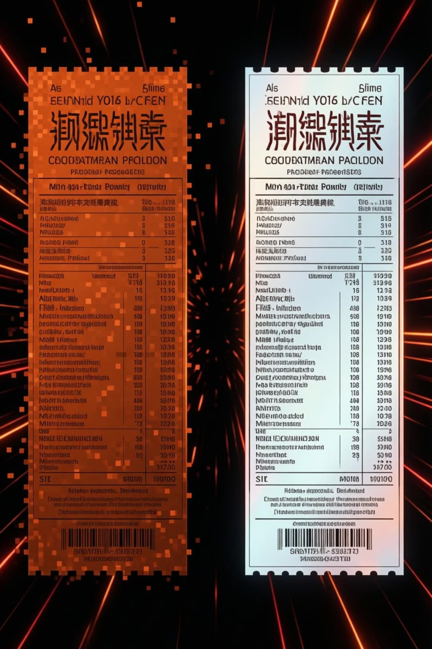



Image Preprocessing
Receipt images often suffer from quality issues such as poor lighting, blur, or noise that significantly impact OCR accuracy. Our preprocessing pipeline addresses these challenges through a series of sophisticated enhancement techniques.
Grayscale Conversion
Simplifies image data whilst preserving essential text information for processing.
Contrast Enhancement
CLAHE algorithm improves text visibility and sharpness across varying lighting conditions.
Noise Removal
Gaussian blur filtering eliminates unwanted artifacts and smooths image texture.
Effective preprocessing can improve OCR accuracy by up to 40%, transforming challenging receipts into clean, readable documents.

Slide 7

OCR Text Extraction
Optical Character Recognition
01
At the heart of our system lies Tesseract OCR, a powerful open-source engine that converts preprocessed images into machine-readable text. The extraction process analyses character patterns, recognises text structures, and outputs formatted data.
Image Input
Preprocessed receipt image loaded into memory
02
Character Recognition
The pytesseract.image_to_string() function serves as our primary interface, processing cleaned images and returning comprehensive text output that captures all visible information from the receipt.
Tesseract analyses and identifies text patterns
03
Text Assembly
Characters combined into words and sentences
04
Output Generation
Structured text data returned for processing

Slide 8
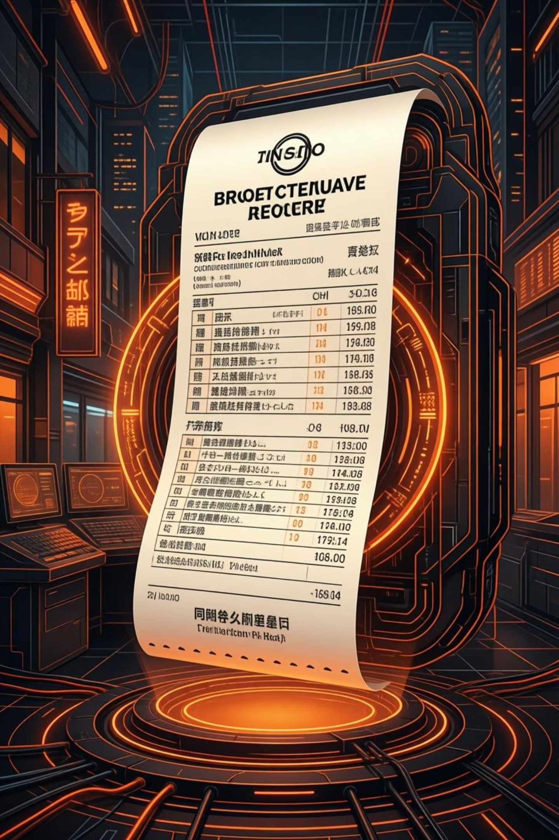
Sample Output
The OCR extraction process successfully captures critical information from receipts, transforming visual data into structured text that can be further analysed and processed.
Merchant Information
Business name, location, and contact details extracted from receipt header.
Transaction Details
Date, time, and transaction reference numbers captured accurately.
Financial Data
Total amount, tax breakdown, and payment method information extracted.
Example extracted text: "ABC Supermarket | Date: 15/03/2024 | Time: 14:30 | Total: ₹1,250.00"

Slide 9

Milestone 1 Status
We have successfully completed all objectives for Milestone 1, establishing a robust foundation for receipt digitisation. Each component has been thoroughly tested and validated to ensure reliable performance.
100%
100%
100%
File Upload
Preprocessing
OCR Extraction
Multi-format support implemented
Image enhancement pipeline active
Text recognition fully functional
Key Achievement
Successfully extracted text from sample receipts with high accuracy, demonstrating the effectiveness of our preprocessing and OCR pipeline.

Slide 10

Milestone 2: Structured Data Extraction & Validation
Milestone 2 focuses on converting raw OCR text into meaningful, structured data and validating it for correctness. In this phase, we extract important receipt fields such as merchant name, date, totals, and line items, validate financial values, detect duplicates, and store clean data into a database for future analysis.

Slide 11





Milestone 2 Objectives
Extract Key Fields
Using Regex and NLP rules to identify receipt fields
Validate Financial Data
Verify subtotal, tax, and total calculations
Handle Missing Values
Intelligently process noisy or incomplete OCR output
Detect Duplicates
Prevent duplicate receipt entries in the system
Store Structured Data
Persist clean data into database for future analysis

Slide 12
Fields Extracted in Milestone 2
The following important fields are extracted from OCR text to convert raw data into clean, usable information:
Receipt Header
Merchant Name
Invoice ID
Date & Time
Currency
Line Items
Item Name
Quantity
Price
Financial Totals
Subtotal
Tax
Total Amount

Slide 13





Technologies Used – Milestone 2
Our system extends the Milestone 1 stack with structured data processing and storage capabilities:
Python
Core logic for parsing, validation, and data handling
Regular Expressions
Extract specific fields like dates, totals, taxes, and prices
Basic NLP Rules
Identify merchants, item sections, and filter noisy text
SQLite Database
Stores structured and validated receipt data persistently
Stream lit
Displays extracted data, validation status, dashboards, and records

Slide 14
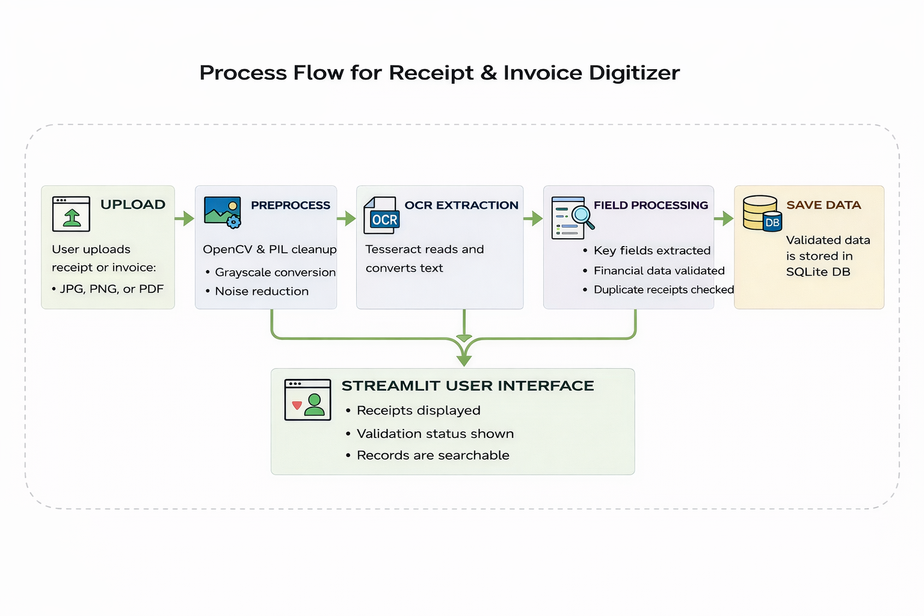

Slide 15
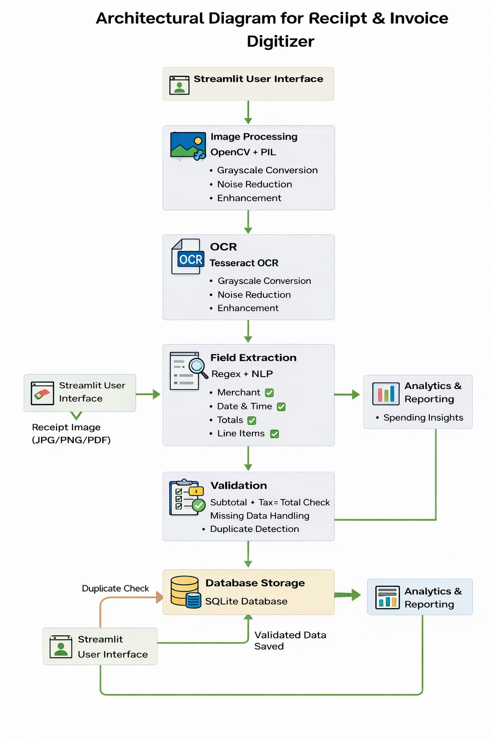
+17
Architecture Design
Users upload receipt images or PDFs through Stream lit UI
Images are enhanced using OpenCV and PIL for better OCR accuracy
Tesseract OCR extracts raw text from processed images
Regex and rule-based NLP extract key receipt fields
Validation layer checks totals, handles missing data, and detects duplicates
SQLite database stores validated receipt data
Stored data is used for analytics and spending insights

Slide 16
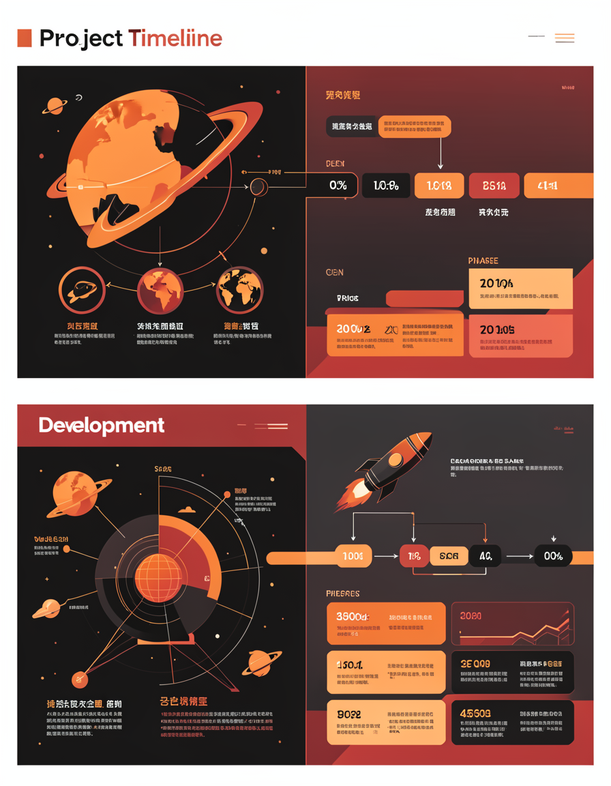
Project Timeline – Milestone 2
Week 3: Field Extraction
Parse OCR text into individual lines
Identify receipt sections (header, items, totals)
Extract merchant, date & time
Extract subtotal, tax, total
Extract line items with quantity and price
Week 4: Validation & Storage
Validate financial correctness (Subtotal + Tax ≈ Total)
Handle missing values intelligently
Detect duplicate receipts
Store clean structured data in SQLite database
Display results in UI dashboards

Slide 17





How It Works – Milestone 2
Step 1: Input from Milestone 1
Raw OCR text generated after image preprocessing and OCR
Step 2: Field Parsing
Regex patterns extract dates, amounts, totals. NLP-style rules identify merchant name and item section boundaries
Step 3: Validation Logic
Automatically handles missing tax, missing subtotal, missing total (calculate from subtotal + tax). Confirms financial consistency and required fields presence
Step 4: Duplicate Detection
Checks database using merchant, date, and total amount
Step 5: Database Storage
Stores structured receipt data in SQLite. Saves raw JSON for traceability

Slide 18
Milestone 2 Status
✅ Field Extraction Completed – All key receipt fields successfully extracted
✅ Validation Logic Implemented – Financial totals verified automatically
✅ Duplicate Detection Working – Prevents saving duplicate receipts
✅ Database Storage Enabled – Structured data stored persistently

Slide 19

Key Achievement – Milestone 2
Successfully transformed noisy OCR text into validated, structured receipt data with financial correctness and database persistence.
This milestone prepares the system for:
Analytics
Deep insights into spending patterns and trends
Spending Insights
Understand where money is being spent
Search & Filtering
Quickly find specific receipts and transactions
Future Automation
Enable intelligent automation capabilities

Slide 20

Thank You

